Slide 1
“Particle Physics Event Classification"
Ambika Sharma
Email: ambikasharma749@gmail.com
Course: Advance AI and ML(LBDSC25082023)

Slide 2
Content
Problem Statement
Introduction (Condition Based Monitoring & GT Propulsion System)
Data Summary
Project Approach
Exploratory Data Analysis
Base Model
Models - Decision Tree and XGBoost
Hyperparameter Tunning
Predications & Feature Importance
Conclusion and Recommendation
References

Slide 3
Problem Statement
IN THE FIELD OF PARTICLE PHYSICS, ACCURATE IDENTIFICATION AND CLASSIFICATION OF EVENTS ARE CRUCIAL FOR UNDERSTANDING FUNDAMENTAL PARTICLES AND THEIR INTERACTIONS.
THE PROVIDED DATASET CONTAINS VARIOUS FEATURES DERIVED FROM PARTICLE PHYSICS EXPERIMENTS, AND THE GOAL IS TO BUILD A MACHINE-LEARNING MODEL TO CLASSIFY EVENTS INTO SIGNAL (s) AND BACKGROUND (b) CATEGORIES. THIS CLASSIFICATION AIDS IN DISTINGUISHING EVENTS OF INTEREST (SIGNAL) FROM BACKGROUND NOISE.

Slide 4
Introduction
Purpose of Particle Accelerators: Particle accelerators enable physicists to study the fundamental nature of matter, space, and time by observing high-energy collisions of subatomic particles. These collisions provide insights into the structure and behavior of the universe's smallest components.
Role of Machine Learning: The data produced from these high-energy collisions often lack precision, prompting researchers to rely on machine learning (ML) techniques to enhance statistical power and extract meaningful features from raw measurements.
Higgs Boson and its Discovery: The Higgs boson, known as the "God particle," was theorized in 1964 by Peter Higgs and others as the particle responsible for giving mass to elementary particles. Its discovery was confirmed in 2012 by CERN's Large Hadron Collider, earning the Nobel Prize in Physics in 2013.
Higgs Boson Decay into Fermions: Physicists investigate different decay channels of the Higgs boson to understand its interaction with fermions. Decay into tau lepton pairs is a crucial mode to prove that the Higgs field provides mass to fermions, though statistical significance remains a challenge.
Dataset Simulation and Structure: The ATLAS full-detector simulation produces a dataset that mimics real proton-proton collisions. This dataset includes both signal events (Higgs boson decays) and background events (other processes), with the training and test sets containing 31 shared features for classification tasks.

Slide 5
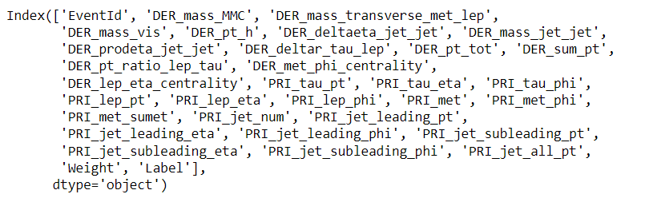
Data Summary

Slide 6
Data Summary
1. Event Information:
`EventId`: Unique identifier for each event.
`Label`: Class label indicating the classification outcome (likely signal vs. background).
2. Derived Features (DER):
`DER_mass_MMC`: Combined mass estimate from visible particles in the event.
`DER_mass_transverse_met_lep`: Transverse mass calculated using missing energy and lepton momentum.
`DER_pt_h`, `DER_pt_tot`, `DER_sum_pt`: Different momentum-related quantities, such as transverse momentum (pt) of the system and total momentum.
`DER_deltar_tau_lep`: Distance between tau and lepton in the detector.
`DER_lep_eta_centrality`: Centrality measure of the lepton in the detector.
3. Primary Features (PRI):
`PRI_tau_pt`, `PRI_lep_pt`, `PRI_met`: Raw transverse momentum for tau, lepton, and missing energy (met).
PRI_jet_num`: Number of jets observed in the event.
PRI_jet_leading_pt`, `PRI_jet_subleading_pt`: Transverse momenta of the leading and sub leading jets.

Slide 7
Data Summary
4. Spatial and Angular Features:
PRI_tau_eta`, `PRI_tau_phi`, `PRI_lep_eta`, `PRI_lep_phi`: Spatial eta and phi coordinates for tau and lepton.
`PRI_jet_leading_eta`, `PRI_jet_leading_phi`: Spatial eta and phi coordinates for the leading jet.
5. Other Features:
-Weight`: Event weight, possibly for handling class imbalance or importance in training.
Missing energy components such as `PRI_met_phi`, `PRI_met_sumet`, and angles `PRI_jet_subleading_eta`, `PRI_jet_all_pt` capture detailed angular and momentum distributions.
Similar to PRI_tau_eta, this feature indicates the pseudorapidity of the lepton, providing information about its
angular position relative to the beamline.
PRI_lep_phi: Azimuthal angle of the lepton.
Similar to PRI_tau_phi, this feature represents the azimuthal angle of the lepton, indicating its orientation in the transverse place.
PRI_met: Missing transverse energy.
Missing transverse energy is a crucial concept in particle physics. It represents the imbalance in transverse

Slide 8
Project Approach
Problem Statement
Data collection and Preprocessing
Exploratory Data Analysis
Feature Selection and Outlier Detection
Modelling
Model performance and evaluation
GT Turbine decay state coefficient Prediction
Recommendation and Conclusion

Slide 9
Exploratory Data Analysis
Class Imbalance: 65.7% background (Class 0) vs. 34.3% signal (Class 1), indicating a need to address imbalance.
Feature Skewness: Several features, like DER_mass_MMC and DER_mass_transverse_met_lep, exhibit right-skewed distributions.
Outlier Detection: Some features show a significant presence of outliers, requiring potential treatment.
Uniform Feature: The EventId variable is uniformly distributed, indicating a balanced sampling.
Correlation Check: Initial correlation analysis may reveal relationships for feature selection

Slide 10
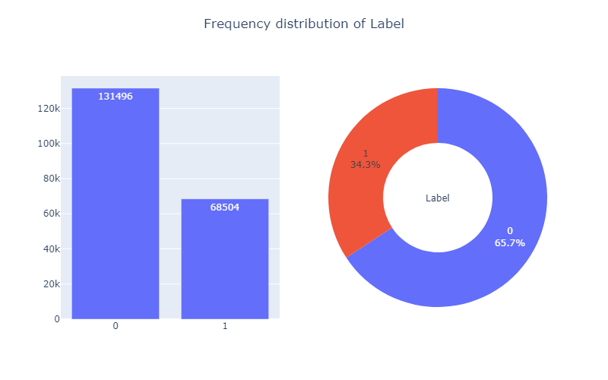
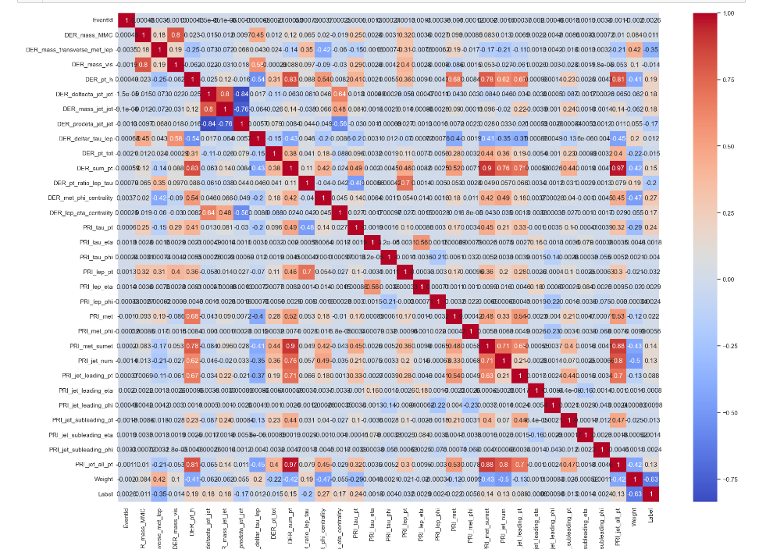
1. Correlation Matrix
Description: A detailed heatmap of the correlation between different features.
Insights: Some strong positive correlations are observed between features such as `DER_mass_vis` and `DER_mass_MMC`, which indicates a relationship that could impact modeling.
Negative correlations exist between features like `PRI_leading_pt` and `PRI_jet_all_pt`.
Highly correlated features might introduce multicollinearity, requiring feature selection or dimensionality reduction techniques like PCA.
2. Label Distribution
Description: The second plot presents the distribution of the target label (`Label`), visualized using both a bar chart and a pie chart.
The target variable is imbalanced, with approximately 65.7% of the observations belonging to class 0 and 34.3% to class 1.
This imbalance could lead to biased model performance favoring the majority class.
3. Histograms of Features
The third set of plots shows histograms for various features, visualizing their distributions.
Many features have skewed distributions, with some exhibiting long tails (`PRI_jet_all_pt`, `DER_mass_MMC`).
Features like `PRI_lep_eta` and `PRI_met` exhibit near-uniform distributions.
The feature `Weight` shows a sharp peak at zero, which may indicate a potential issue or specific encoding in the data.

Slide 11
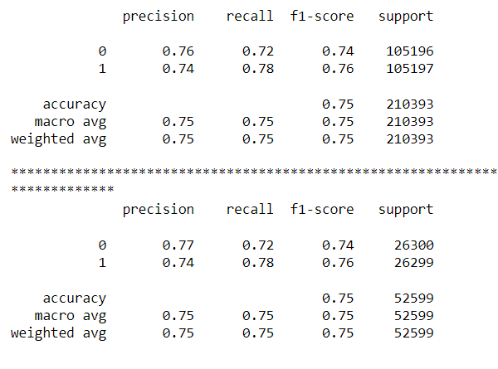
Base Model Logistic Regression
Logistic Regression has balanced precision and recall for both classes, making it a decent choice for moderately imbalanced data.
It performs similarly on both training and test sets, indicating no overfitting.
Suitable for use when interpretability is important.

Slide 12
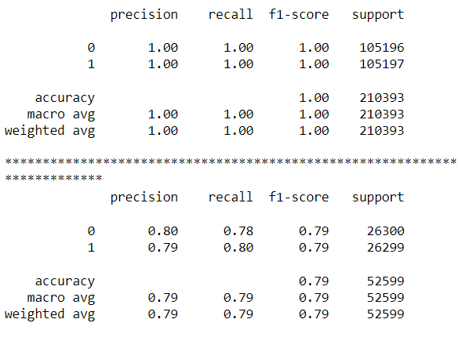
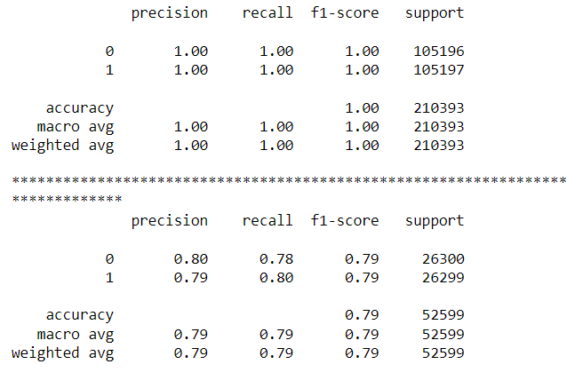
Models
Decision Tree
XGBoost

Slide 13
Hyperparameter Tunning
Best parameters for Logistic Regression: {'solver': 'lbfgs', 'penalty': 'l2', 'max_iter': 200, 'C': 100}
Logistic Regression Training Accuracy: 0.7326
Logistic Regression Test Accuracy: 0.7361
Best parameters for Decision Tree Classifier: {'min_samples_split': 10, 'max_features': 'log2', 'max_depth': 20, 'class_weight': None}
Decision Tree Classifier Training Accuracy: 0.9022
Decision Tree Classifier Test Accuracy: 0.7934
Best parameters for XGBoost Classifier: {'subsample': 0.9, 'scale_pos_weight': 2, 'n_estimators': 300, 'max_depth': 7, 'learning_rate': 0.2}
XGBoost Classifier Training Accuracy: 0.9183
XGBoost Classifier Test Accuracy: 0.8529

Slide 14
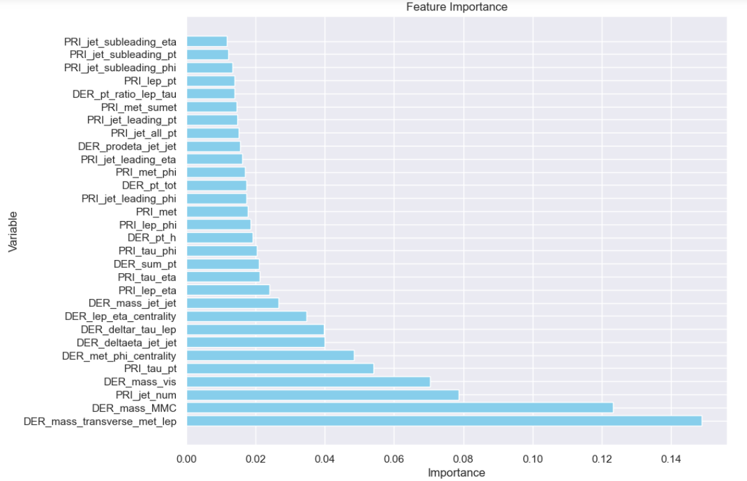
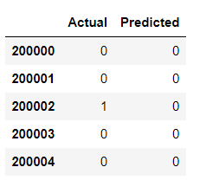
Prediction & Feature Importance
Let’s see first five rows of prediction;

Slide 15
Recommendation and Conclusion
Recommendation: -
Enhance Feature Selection: Refine the selection of features by focusing on high-correlation variables such as transverse momentum, derived masses, and pseudorapidity. This will improve model performance and interpretability.
Address Class Imbalance: Implement techniques such as resampling (oversampling or under sampling) or class weighting to manage any imbalance between signal and background events. This will help the model perform better on underrepresented signal events.
Explore Advanced Models: Beyond Random Forest, consider using Gradient Boosting, XGBoost, or deep learning models to further enhance classification accuracy. These algorithms may capture complex patterns in the data more effectively.
Hyperparameter Tuning: Conduct systematic hyperparameter tuning using grid search or random search with cross-validation to ensure optimal performance and generalization on unseen data.
Conclusion: -
The particle physics event classification project demonstrates the potential of machine learning to automate and improve the identification of signal events from experimental data. By analyzing key features like transverse momentum, pseudo rapidity, and derived masses, the model effectively distinguishes signal (s) from background (b) events, aiding physicists in identifying meaningful interactions.
The exploratory data analysis revealed critical insights into the relationships between these features, guiding the selection of relevant variables for the classification task. Leveraging machine learning, particularly Random Forest, has shown promising results, although further improvements can be achieved through hyperparameter tuning and the exploration of more advanced models.
Overall, this project represents a significant step towards improving efficiency in particle physics research, enabling faster and more accurate identification of events that may lead to important discoveries.

Slide 16
Thank You

